Slide 1
Navigating the Transition: Supporting Youth Aging Out of Foster Care
by Brigit VanGraafeiland DNP, CPNP-PC, CNE, FAAN, FAANP
Notes:
This presentation aims to equip social workers, foster parents, and policymakers with the knowledge and tools needed to support youth transitioning out of foster care.

Slide 2
Objectives
Define what it means to "age out" of foster care and identify the typical age at which this occurs.
Recognize the common challenges faced by youth aging out of foster care, including financial instability, lack of support systems, and housing insecurity.
Integrate basic life skills necessary for independent living, such as budgeting, cooking, job readiness, navigating health insurance plans and getting a driver’s license into their plan of care for youth in foster care.
Identify available educational resources, including vocational training, scholarships, and continuing education options.
Advocate for the importance of building support systems and how to connect with mentors, peer support groups, and community resources.

Slide 3
Understanding "Aging Out"
Youth "age out" of foster care when they reach the legal age of emancipation, typically 18 in most states, though some states extend this to 21.
The transition from foster care to independent adulthood can be particularly challenging, often marked by limited resources, social isolation, and a lack of access to essential support systems.
Notes:
This means they are no longer under the legal responsibility of the foster care system, often with limited support.
This transition period necessitates proactive planning and tailored support services.

Slide 4
Current Data
More than 23,000 children will age out of the US foster care system every year.
After reaching the age of 18, 20% of the children who were in foster care will become instantly homeless.
Only 1 out of every 2 foster kids who age out of the system will have some form of gainful employment by the age of 24.
7 out of 10 girls who age out of the foster care system will become pregnant before the age of 21.
(US Department of Health and Human Services 2022)
Notes:
The current data on foster care is discouraging. But we can do better, which I will discuss later.

Slide 5
Current Data
Children with disabilities are twice as likely to age out of the foster care system.
Youth who enter the system after the age of 12 years are more likely to age out of care.
The percentage of children who age out of the foster care system and still suffer from the direct effects of PTSD: 25%.
There is less than a 3% chance for children who have aged out of foster care to earn a college degree at any point in their life.
Notes:
What makes a youth who ages out even more vulnerable.

Slide 6
Outcomes
40% homeless
81% were parents
40% on public assistance
2-4 years after aging out
51% unemployed
Up to 40% incarcerated
46% without a high school diploma
40% with substance abuse
https://www.childwelfare.gov/
Notes:
While the initial data once youth age out, the data gets even worse 2-4 years after aging out. This speaks to the lack of continued services among our youth. The further removed they are from care the worse their longer term outcomes becomes.

Slide 7
Barriers and Challenges to Aging Out
Adolescents in FC often have fragmented care
Healthcare providers do not…
Recognize signs and symptoms of trauma
Do not understand the needs of youth in FC
Foster parents are often given limiting training for caring for youth in FC
Youth can be very guarded and mistrusting making it difficult to engage in treatment and services
Limited access often to services, especially mental health services for youth in FC

Slide 8

Common Challenges
Financial Instability
Lack of Support Systems
Many youth aging out lack financial literacy, employment history, and stable income, making it difficult to manage expenses and secure housing. They may also face difficulty accessing financial aid or scholarships.
Building strong support systems is crucial for independent living. Without a network of family, friends, and mentors, youth may struggle with emotional and practical challenges, increasing the risk of isolation.
Housing Insecurity
Finding affordable and safe housing can be a daunting task for youth transitioning out of foster care, especially when navigating a competitive rental market and facing limited financial resources.
Notes:
Building a solid foundation for independent living is crucial. Focus on equipping youth with practical skills that empower them to navigate daily challenges and thrive.
Budgeting basics, managing bank accounts, and understanding credit are vital for financial independence. Explore resources like online budgeting tools, credit counseling services, and financial literacy workshops
Resume writing, interview skills, and networking strategies are essential for finding employment. Connect youth with career counseling, job training programs, and mentoring opportunities.
Cooking, meal planning, and time management are critical for independent living. Provide opportunities for practical skill-building, such as cooking classes, time management workshops, and community resources.
Access to legal aid, driver's license, social security card, birth certificate, and healthcare insurance are vital for navigating legal matters. Connect with legal advocacy organizations, government agencies, and community resources.

Slide 9






Integrating Life Skills
Budgeting: Teach youth how to manage money effectively, create a budget, and understand financial responsibilities.
Cooking: Empower youth with basic cooking skills to prepare healthy and affordable meals, fostering independence and promoting healthy eating habits.
Job Readiness: Assist youth with resume building, interview preparation, and job search strategies, helping them navigate the job market and secure employment.
Health Insurance: Guide youth through navigating healthcare systems, understanding insurance plans, and accessing essential medical services.
Driver’s License: Assist youth with obtaining a driver’s license, opening up opportunities for transportation, employment, and overall independence.

Slide 10
Transitional Support
Academic support
Career preparation
Housing education and home-management skills
Health education
Transitional housing
https://www.childwelfare.gov/
Notes:
So what can we do?
There are certain aspects of transitioning that help to ensure a greater chance of success.
Academic support-including tutoring, study skills training, literacy training, and help accessing educational resources
Career preparation-Vocational and career assessment
Job-seeking and job-placement support
Budgeting, financial management, and consumer-skills training and support
Health education-including on topics such as family planning, sex education, healthy relationships, parenting, risk prevention, and substance use prevention
Transitional housing-such as group homes, foster homes, or subsidized apartments, with gradually decreasing levels of supervision

Slide 11

Educational Resources
Vocational Training - Provide information about vocational training programs that equip youth with specialized skills for specific careers.
Scholarships - Help youth identify and apply for scholarships that can cover tuition, housing, and living expenses, reducing financial burdens.
Continuing Education - Encourage youth to explore options for continuing education, such as community college, online courses, and apprenticeships, fostering lifelong learning.
https://www.childwelfare.gov/
Notes:
For those who haven't completed high school, provide access to diploma programs, GED preparation classes, and alternative educational pathways.
Explore career-specific training programs, apprenticeships, and vocational schools to develop job-ready skills and enhance employment opportunities.
Support youth in accessing college resources, financial aid, and scholarships to pursue higher education and broaden their horizons.

Slide 12
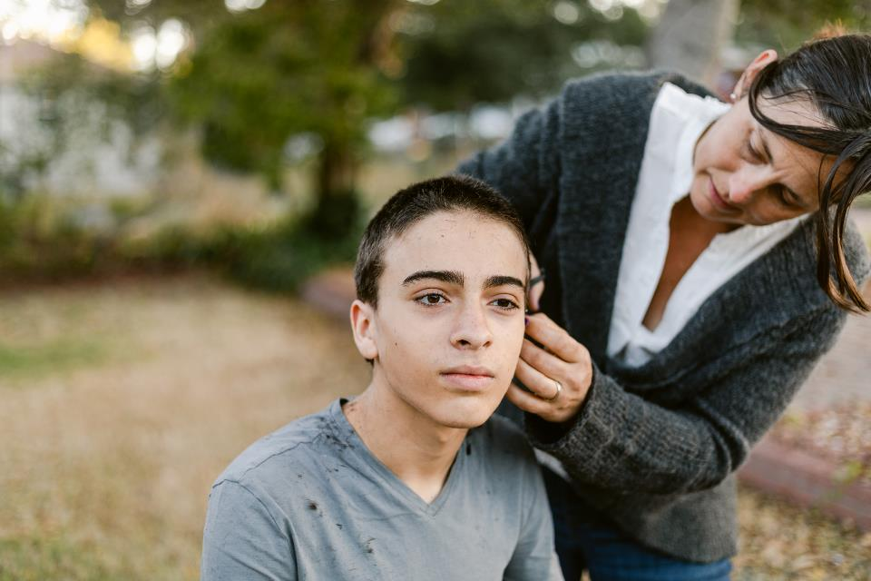
Building Support Systems
Mentors: Connect youth with positive adult role models who can provide guidance, support, and a stable presence in their lives.
Peer Support Groups: Create opportunities for youth to connect with peers who have shared experiences, fostering a sense of community and understanding.
Community Resources: Introduce youth to local organizations and resources that offer services such as housing assistance, job training, and mental health support.
https://www.childwelfare.gov/
Notes:
1. Connect youth with mentors and role models who can provide guidance, support, and encouragement during their transition.
2. Facilitate the creation of peer support groups where youth can connect with others who have shared experiences and build a sense of community.
3. Connect youth with local non-profits, government programs, counseling services, and other community resources to access essential support.

Slide 13



Policy Advocacy
Extended Foster Care
1
Advocate for policies that extend foster care services to age 21, providing additional support and resources for young adults transitioning out of care.
Financial Assistance
2
Promote policies that increase financial aid and scholarships available to youth aging out of foster care, enabling them to access education and career opportunities.
Housing Support
3
Support policies that provide affordable housing options for youth aging out of foster care, addressing housing insecurity and creating stable living environments.
Notes:
Collaboration
Successful transitions require collaboration between youth, social workers, foster parents, and community partners to provide comprehensive support and guidance.
Advocacy
Advocate for policies and programs that address the unique needs of youth aging out of foster care, including extended foster care, financial assistance, and mental health services.
Empowerment
Equip youth with the knowledge, skills, and resources to navigate their transition, build independence, and achieve their full potential.

Slide 14
Transition Resources
Social Support
System Relationships
John F. Chafee Foster Care Independence Program
Independent Living Coach
Foster Care Transition Toolkit
https://www2.ed.gov/about/inits/ed/foster-care/youth-transition-toolkit.pdf

Slide 15

Key Takeaways and Next Steps
1
Youth aging out of foster care face significant challenges, highlighting the need for comprehensive support and resources.
2
Integrating essential life skills into their plan of care is crucial for their success in transitioning to independent adulthood.
3
Advocating for policy changes that address financial, housing, and educational barriers is essential to ensure a brighter future for these young adults.
4
By working together, we can create a more supportive environment for youth transitioning out of foster care, empowering them to build fulfilling and successful lives.
Notes:
We must continue to invest in programs and initiatives that support youth aging out of foster care, building a network of resources and opportunities that empower them to thrive in their new chapter. We must collaborate and advocate for policies that ensure their success and well-being.

